Slide 1
Lesson 1
An introduction to relational databases
Aspen Olmsted, Ph.D.
Lecture adapted from Murach’s MySQL Textbooks

Slide 2
Objectives
Knowledge
Identify the three main hardware components of a client/server system.
Describe the way a client accesses the database on a server using these terms: application software, data access API, database management system, SQL query, and query results.
Describe the way a relational database is organized using these terms: tables, columns, rows, cells, primary keys, unique keys, and foreign keys.
Identify the three types of relationships that can exist between two tables.
Describe the way the columns in a table are defined using these terms: data type, null value, and default value.

Slide 3
Objectives (continued)
Describe how an entity relationship diagram can show how the tables in a database are defined and related.
Describe the difference between DML statements and DDL statements.
List three coding techniques that can make your SQL code easier to read and maintain.
Describe the use of a database driver.

Slide 4
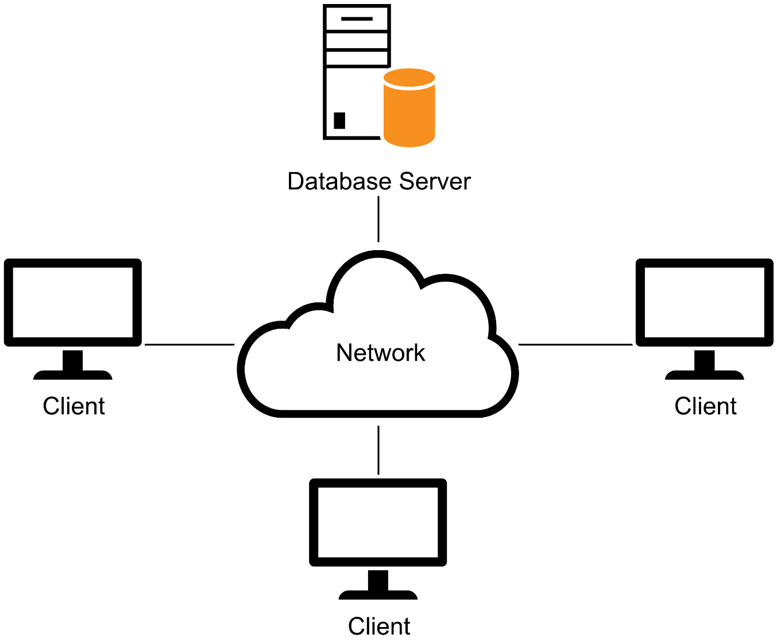
A simple client/server system

Slide 5
The three hardware components of a client/server system
Clients
Server
Network
Terms to know about client/server systems
Local area network (LAN)
Wide area network (WAN)
Enterprise system

Slide 6
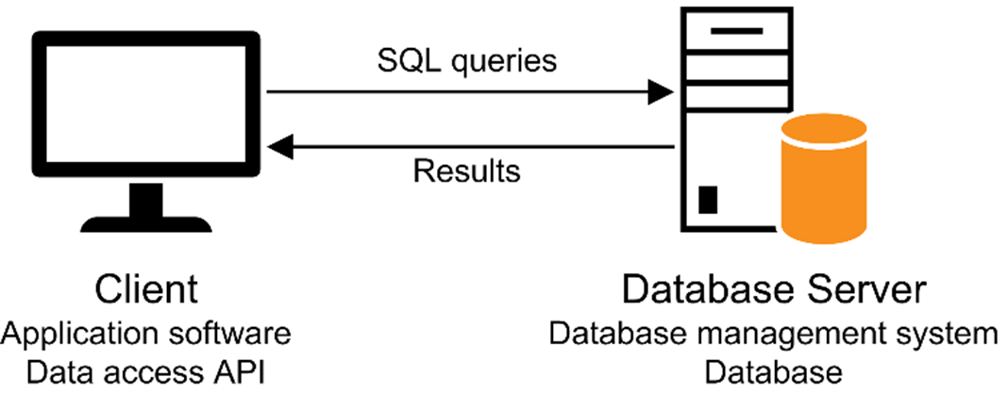
Client software, server software, and the SQL interface

Slide 7
Server software
Database management system (DBMS)
The DBMS does the back-end processing
Client software
Application software
Data access API (application programming interface)
The client software does the front-end processing

Slide 8
The SQL interface
The application software communicates with the DBMS by sending SQL queries through the data access API.
When the DBMS receives a query, it provides a service like returning the requested data (the query results) to the client.
SQL stands for Structured Query Language, which is the standard language for working with a relational database.

Slide 9
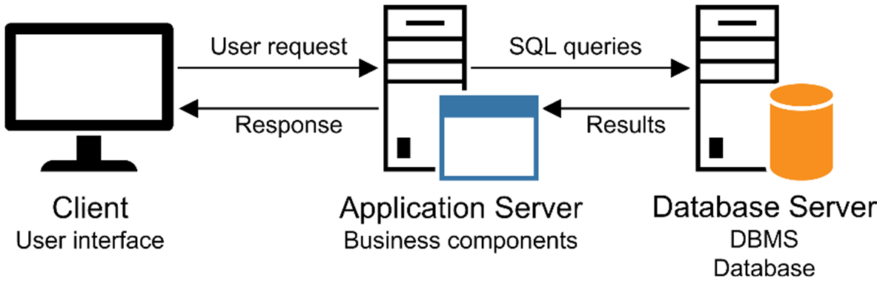
A networked system with an application server

Slide 10
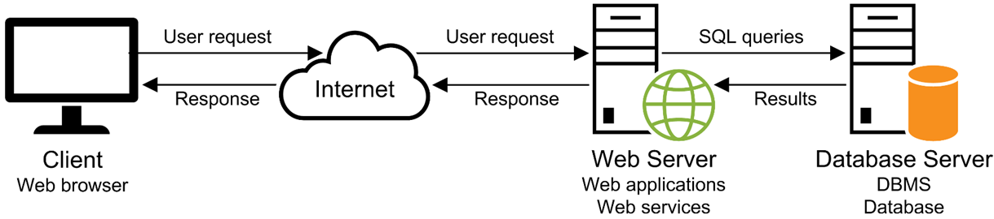
A simple web-based system

Slide 11
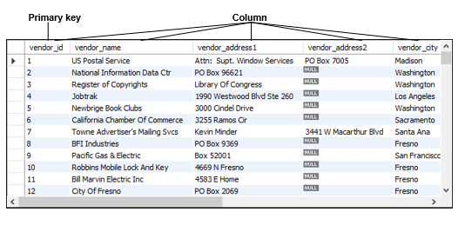
The Vendors table in an Accounts Payable (AP) database

Slide 12
Terms to know about database tables
Relational database
Table
Column
Row
Cell
Primary key
Composite primary key
Non-primary key (unique key)
Index

Slide 13
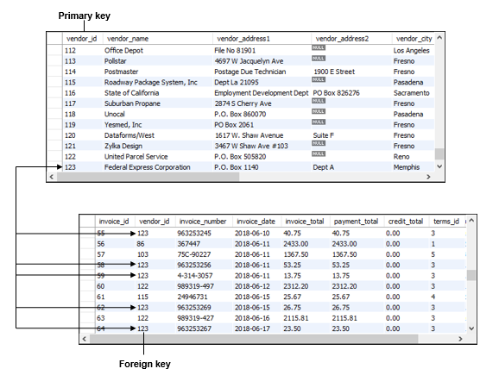
The relationship between two tables

Slide 14
Terms to know about table relationships
Foreign key
Referential integrity
One-to-many relationship
One-to-one relationship
Many-to-many relationship

Slide 15
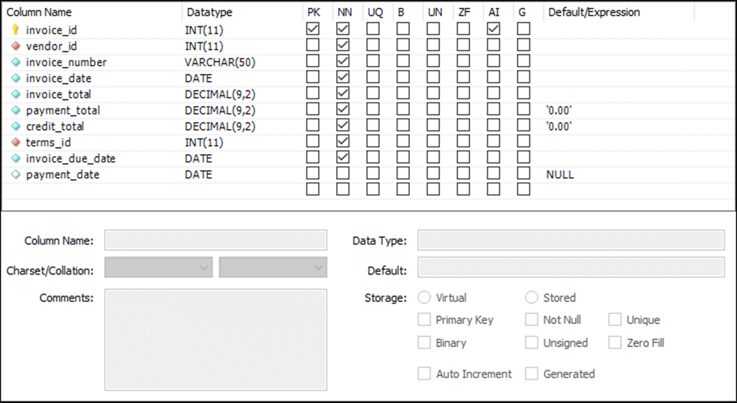
The columns of the Invoices table

Slide 16
Common MySQL data types
CHAR
VARCHAR
INT
DECIMAL
FLOAT
DATE

Slide 17
Terms to know about columns
Data type
Null value
Default value
Auto increment column

Slide 18
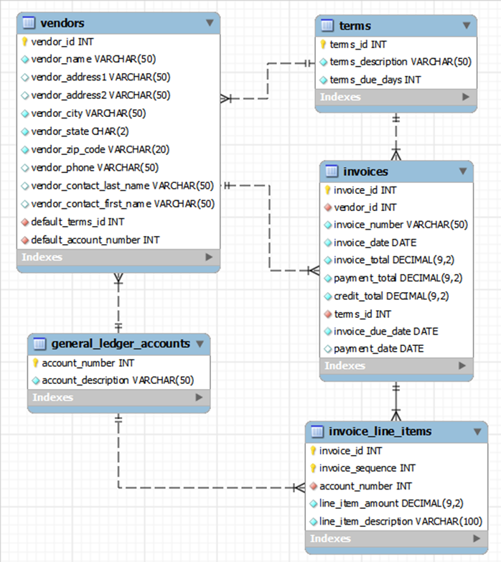
An EER diagram for the AP database

Slide 19
How knowing “standard SQL” helps you
Basic SQL statements are the same for all dialects.
Once you know one dialect, you can easily learn others.
How knowing “standard SQL” does not help you
Most applications require modification when moved to another database.

Slide 20
First database releases
Oracle - 1979
DB2 - 1985
SQL Server - 1987
MySQL - 2000
Primary platforms
Oracle - Unix, OS/390 and z/OS
DB2 - Unix, OS/390 and z/OS SQL Server - Windows
MySQL - Unix, Windows, Mac OS

Slide 21
SQL Statements

Slide 22
SQL DML statements
SELECT
INSERT
UPDATE
DELETE
SQL DDL statements
CREATE DATABASE, TABLE, INDEX
ALTER TABLE, INDEX
DROP DATABASE, TABLE, INDEX

Slide 23
A statement that creates a new database
CREATE DATABASE ap
A statement that selects the current database
USE ap

Slide 24
A statement that creates a new table
CREATE TABLE invoices
(
invoice_id INT PRIMARY KEY
AUTO_INCREMENT,
vendor_id INT NOT NULL,
invoice_number VARCHAR(50) NOT NULL,
invoice_date DATE NOT NULL,
invoice_total DECIMAL(9,2) NOT NULL,
payment_total DECIMAL(9,2) DEFAULT 0,
credit_total DECIMAL(9,2) DEFAULT 0,
terms_id INT NOT NULL,
invoice_due_date DATE NOT NULL,
payment_date DATE,
CONSTRAINT invoices_fk_vendors
FOREIGN KEY (vendor_id)
REFERENCES vendors (vendor_id),
CONSTRAINT invoices_fk_terms
FOREIGN KEY (terms_id)
REFERENCES terms (terms_id)
)

Slide 25
A statement that adds a new column to a table
ALTER TABLE invoices
ADD balance_due DECIMAL(9,2)
A statement that deletes the new column
ALTER TABLE invoices
DROP COLUMN balance_due
A statement that creates an index on the table
CREATE INDEX invoices_vendor_id_index
ON invoices (vendor_id)
A statement that deletes the new index
DROP INDEX invoices_vendor_id_index

Slide 26
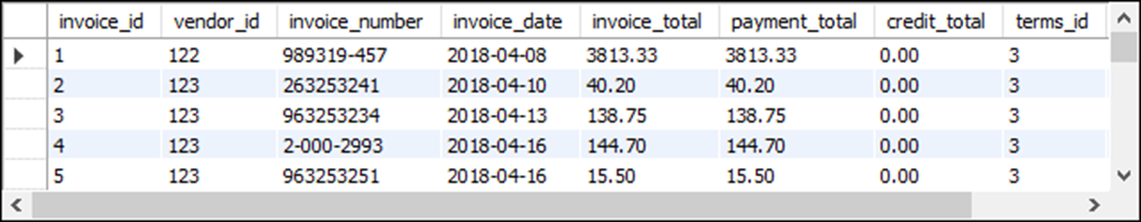
The Invoices base table

Slide 27
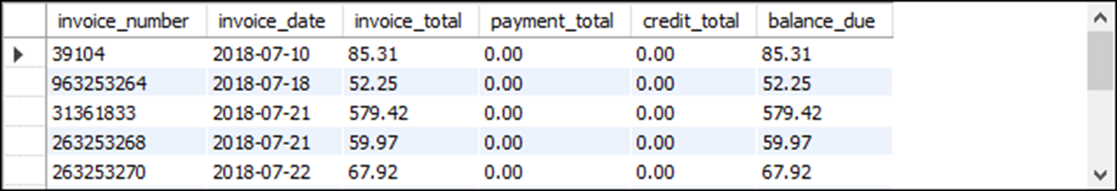
A SELECT statement that retrieves and sorts selected columns and rows
SELECT invoice_number, invoice_date, invoice_total,
payment_total, credit_total,
invoice_total - payment_total - credit_total AS balance_due
FROM invoices
WHERE invoice_total - payment_total - credit_total > 0
ORDER BY invoice_date
The result set defined by the SELECT statement

Slide 28
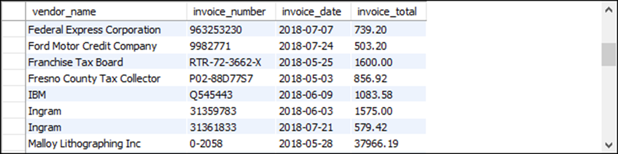
A SELECT statement that joins data
SELECT vendor_name, invoice_number, invoice_date,
invoice_total
FROM vendors INNER JOIN invoices
ON vendors.vendor_id = invoices.vendor_id
WHERE invoice_total >= 500
ORDER BY vendor_name, invoice_total DESC
The result set defined by the SELECT statement

Slide 29
Terms to know about SQL
Query
Base table
Result table (result set)
Calculated value
Join
Inner join
Outer join

Slide 30
A statement that adds a row to the Invoices table
INSERT INTO invoices
(vendor_id, invoice_number, invoice_date, invoice_total, terms_id, invoice_due_date)
VALUES (12, '3289175', '2018-07-18', 165, 3, '2018-08-17')

Slide 31
A statement that changes the value of a column for one row
UPDATE invoices
SET credit_total = 35.89
WHERE invoice_number = '367447'
A statement that changes the value of a column for multiple rows
UPDATE invoices
SET invoice_due_date
= DATE_ADD(invoice_due_date, INTERVAL 30 DAY)
WHERE terms_id = 4

Slide 32
A statement that deletes a selected invoice from the Invoices table
DELETE FROM invoices
WHERE invoice_number = '4-342-8069'
A statement that deletes all paid invoices from the Invoices table
DELETE FROM invoices
WHERE invoice_total - payment_total - credit_total = 0

Slide 33
A SELECT statement that’s difficult to read
select invoice_number, invoice_date, invoice_total, payment_total, credit_total, invoice_total - payment_total – credit_total as balance_due from invoices where invoice_total – payment_total - credit_total > 0 order by invoice_date
A SELECT statement that’s easy to read
SELECT invoice_number, invoice_date, invoice_total,
payment_total, credit_total,
invoice_total - payment_total - credit_total AS balance_due
FROM invoices
WHERE invoice_total - payment_total - credit_total > 0
ORDER BY invoice_date

Slide 34
A SELECT statement with a block comment
/* Author: Aspen Olmsted Date: 8/22/2018 */ SELECT invoice_number, invoice_date, invoice_total,
invoice_total - payment_total - credit_total
AS balance_due
FROM invoices
A SELECT statement with a single-line comment
-- The fourth column calculates the balance due
SELECT invoice_number, invoice_date, invoice_total,
invoice_total - payment_total - credit_total
AS balance_due
FROM invoices

Slide 35
Coding recommendations
Capitalize all keywords.
Use lowercase for the other code.
Separate the words in names with underscores.
Start each clause on a new line.
Break long clauses into multiple lines.
Indent continued lines.
Use comments only for code that is difficult to understand.
Make sure that the comments are correct and up-to-date.
*Note
Line breaks, white space, indentation, and capitalization have no effect on the operation of a statement.

Slide 36
Call Level Interfaces

Slide 37
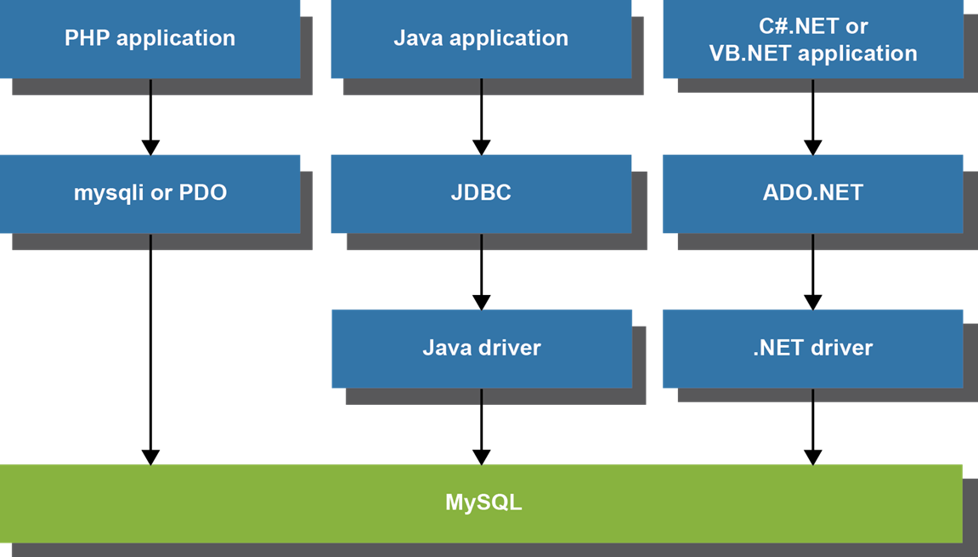
Common options for accessing MySQL data

Slide 38
Two commonly used MySQL drivers
Connector/J
Connector/Net

Slide 39
Terms to know about accessing MySQL data
Data access API
mysqli API (for PHP)
PDO API (for PHP)
JDBC API (for Java)
ADO.NET API (for .NET languages)
Database driver

Slide 40
PHP code that gets data from MySQL (part 1)
<?php
$query =
"SELECT vendor_name, invoice_number, invoice_total
FROM vendors INNER JOIN invoices
ON vendors.vendor_id = invoices.vendor_id
WHERE invoice_total >= 500
ORDER BY vendor_name, invoice_total DESC";
$dsn = 'mysql:host=localhost;dbname=ap';
$username = 'root';
$password = 'sesame';
try {
$db = new PDO($dsn, $username, $password);
} catch (PDOException $e) {
$error_message = $e->getMessage();
echo $error_message;
exit();
}
$statement = $db->prepare($query);
$statement->execute();
$rows = $statement->fetchAll();
?>

Slide 41
PHP code that gets data from MySQL (part 2)
<!DOCTYPE html>
<html lang="en">
<head>
<title>DB Test</title>
</head>
<body>
<h1>Invoices with totals over 500:</h1>
<?php foreach ($rows as $row) : ?>
<p>
Vendor: <?php echo $row['vendor_name']; ?><br/>
Invoice No: <?php echo $row['invoice_number']; ?>
<br/>
Total: $<?php echo
number_format($row['invoice_total'], 2); ?>
</p>
<?php endforeach; ?>
</body>
</html>

Slide 42
Java code that gets data from MySQL (part 1)
import java.sql.*;
import java.text.NumberFormat;
public class DBTestApp
{
public static void main(String args[])
{
String query =
"SELECT vendor_name, invoice_number, invoice_total " +
"FROM vendors INNER JOIN invoices " +
"ON vendors.vendor_id = invoices.vendor_id " +
"WHERE invoice_total >= 500 " +
"ORDER BY vendor_name, invoice_total DESC";
String dbUrl = "jdbc:mysql://localhost:3306/ap";
String username = "root";
String password = "sesame";
try (Connection connection =
DriverManager.getConnection(
dbUrl, username, password);
PreparedStatement ps =
connection.prepareStatement(query);
ResultSet rs = ps.executeQuery())

Slide 43
Java code that gets data from MySQL (part 2)
{
System.out.println("Invoices with totals over 500:\n");
while(rs.next())
{
String vendorName = rs.getString("vendor_name");
String invoiceNumber =
rs.getString("invoice_number");
double invoiceTotal = rs.getDouble("invoice_total");
NumberFormat currency =
NumberFormat.getCurrencyInstance();
String invoiceTotalString =
currency.format(invoiceTotal);
System.out.println(
"Vendor: " + vendorName + "\n" +
"Invoice No: " + invoiceNumber + "\n" +
"Total: " + invoiceTotalString + "\n");
}
}
catch(SQLException e)
{
System.out.println(e.getMessage());
}
}
}

